Slide 1
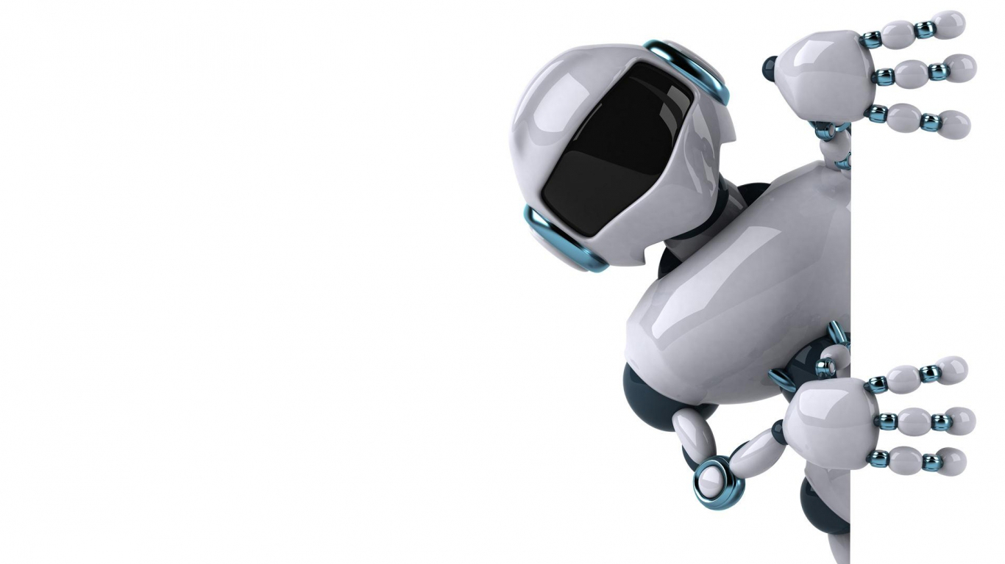
ROBOHAND
ROBT 206 Microcontrollers with Lab
Adambek Aishabibi
Khuzyakhmetova Assiya
Sabyrov Arman
Suleimenov Aidarbek
Tuleuov Adilet

Slide 2
Project aims
Building the simulation of a basic motion of a human hand
Reach the basic functionality: contraction of the fingers and the movement of a thumb in a plane around the wrist;
Implementation of a combinational logic through Arduino IDE

Slide 3
Design
Following the recommendations proposed by Mano and Kime in “Logic and Computer Design Fundamentals” (2014) we structure the design process in the five steps and also integrate the details on a process of building a hand
Specifications - Formulation - Optimization - Circuit Design - Verification

Slide 4
SPECIFICATIONS
RoboHand - a mechanical programmable arm that functions similar to a human arm.
Human arm motion is detected with help of flex sensors attached to the glove worn by an a tester (the glove provided by a Lab Instructor).

Slide 5
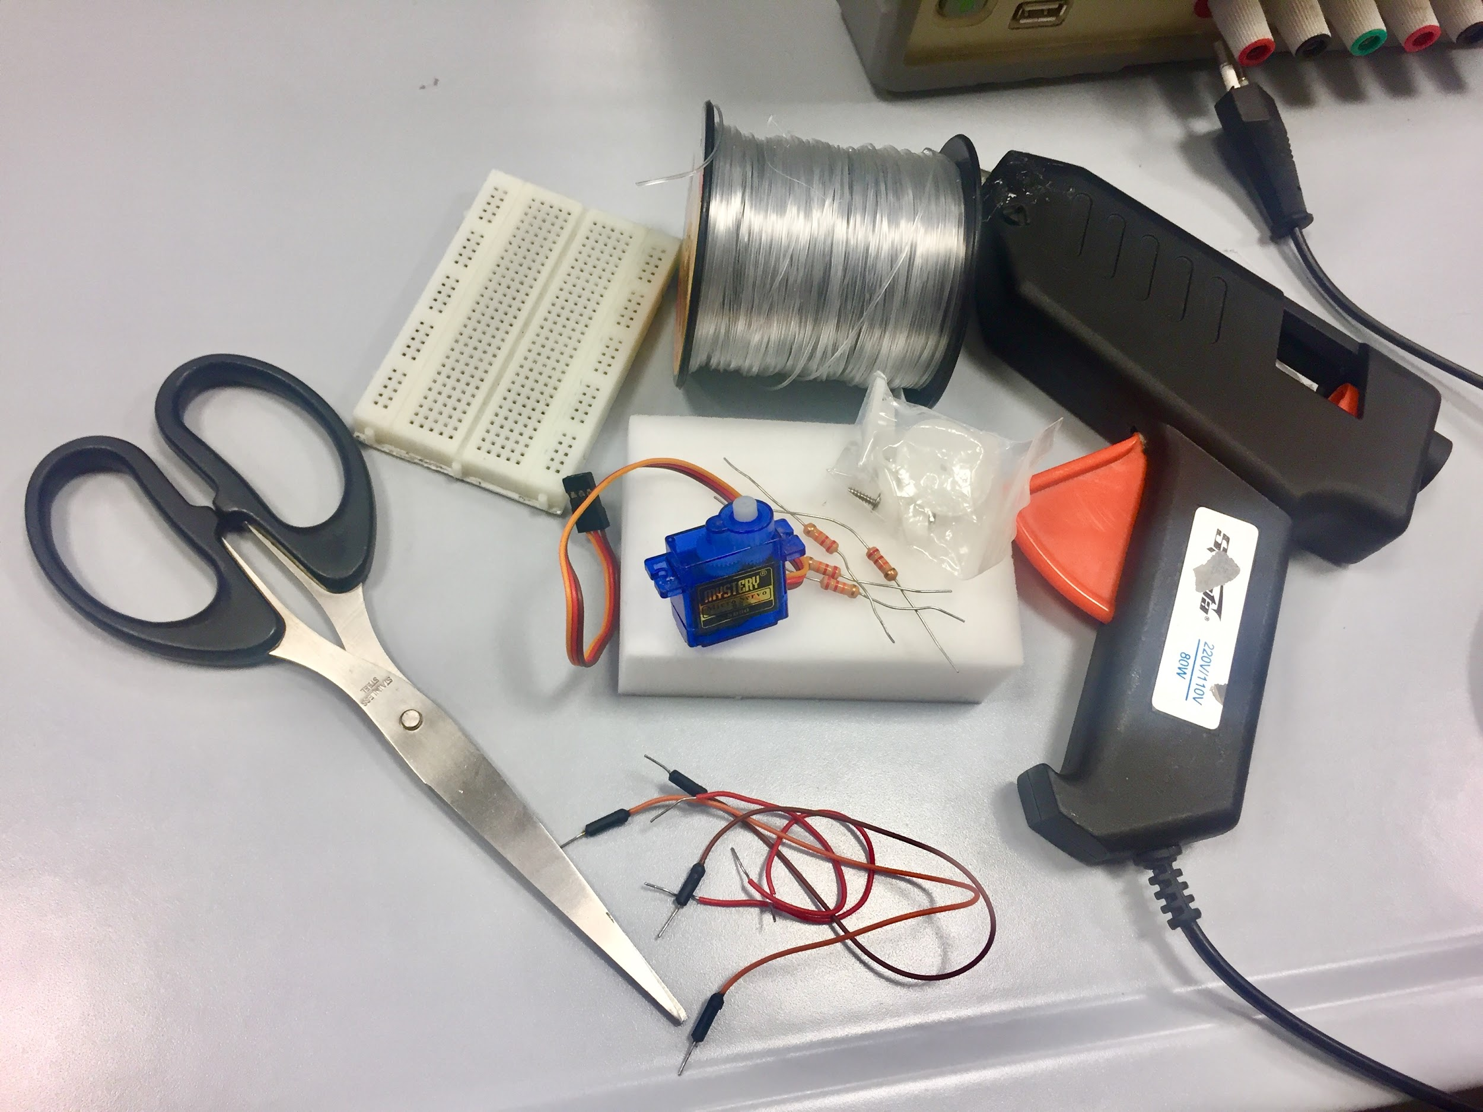
RoboHand components
Foam;
Fishline;
Wires;
Flex sensors;
Servo motors;
12k ohms resistors.
Breadboard.

Slide 6
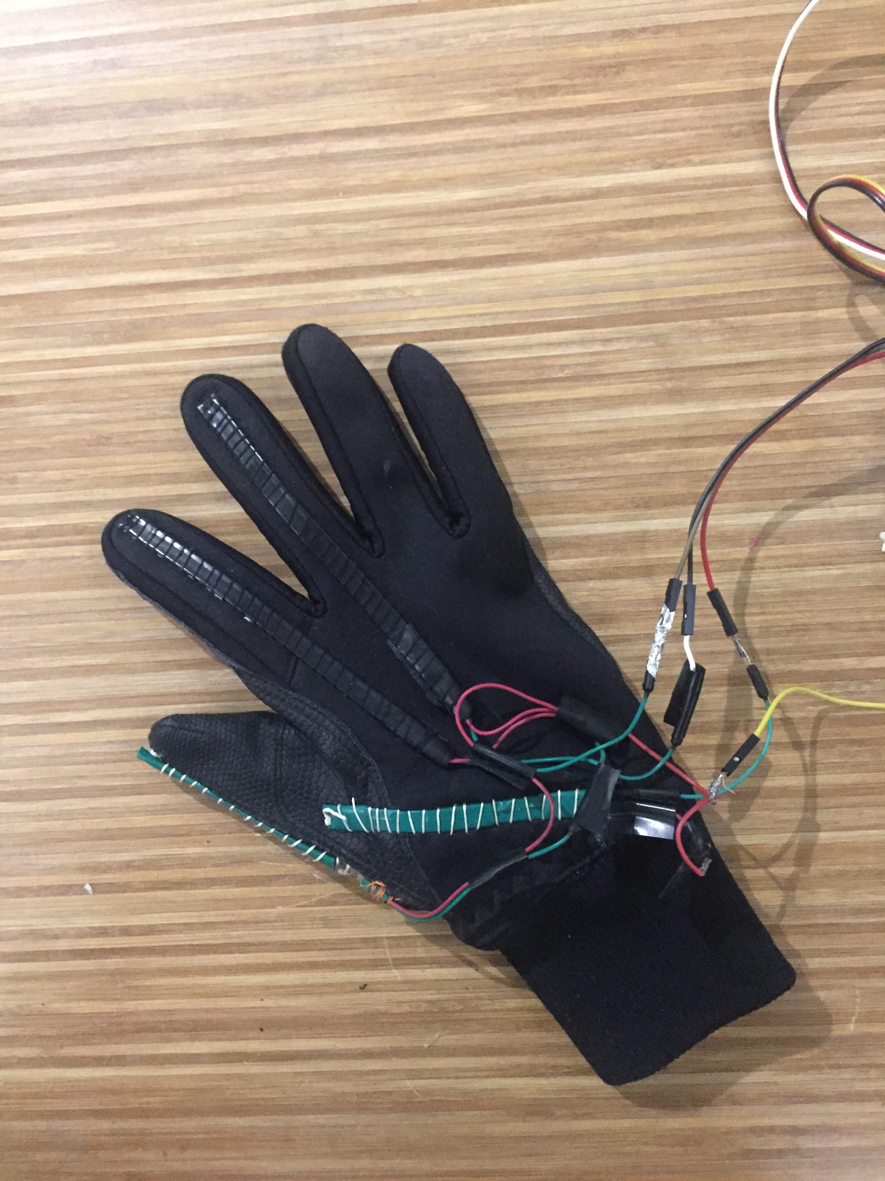
The glove with flex sensors that detects the motion of a human hand

Slide 7
FORMULATION
Boolean Equations and State Tables - not feasible to derive as wide range of analogous input from flex sensors;
The alternative technique: mapping the analogous inputs to the ranges of input values for servo motors.
*A servo motor is a device that turns an electrical signal into a rotary movement that can be precisely controlled.
The challenge: to write the correctly functioning software.

Slide 8
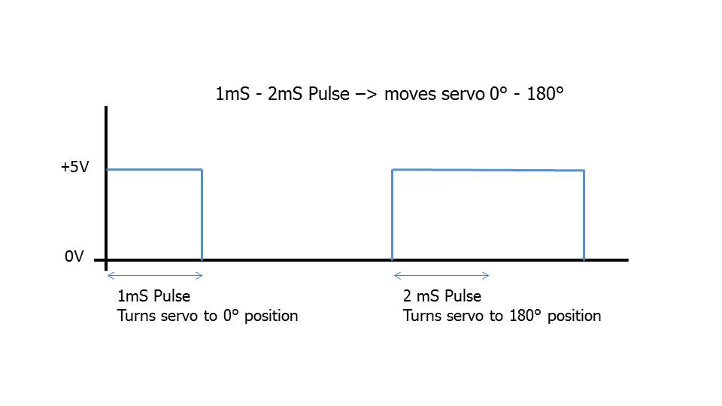
Figure 1. PWM for Servo Motors. Source: "How To Control A Servo Using Pulse Width Modulation (PWM) - Smartmicrocontroller.Com" 2018.

Slide 9
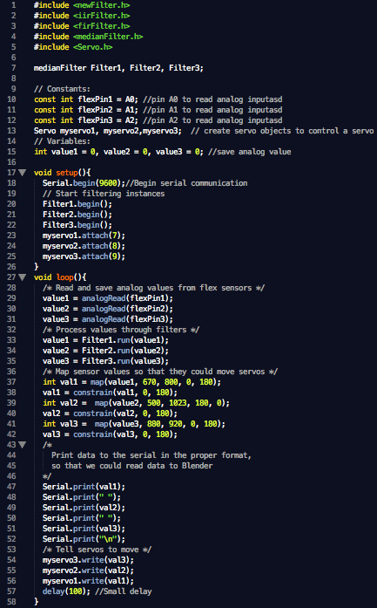
Optimization
Encountered issues:
Noisiness of flex sensor readings
Lack of flex sensors
Solutions:
Median filtering of data readings
3 fingers

Slide 10
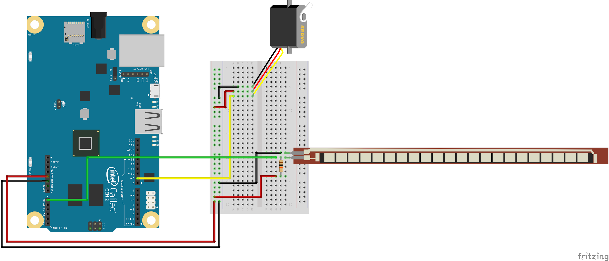
Circuit Design
Basic combinational logic principles;
Readings from the flex sensors = analogous inputs;
Servo motors connected to the digital pins of the Arduino Board;
In the actual circuit design, two more flex sensors were added to read in the motion of 3 fingers.

Slide 11

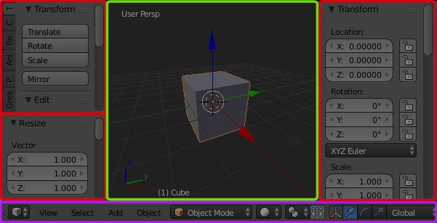
Blender Simulation
Free and Open 3D Creation Software

Slide 12
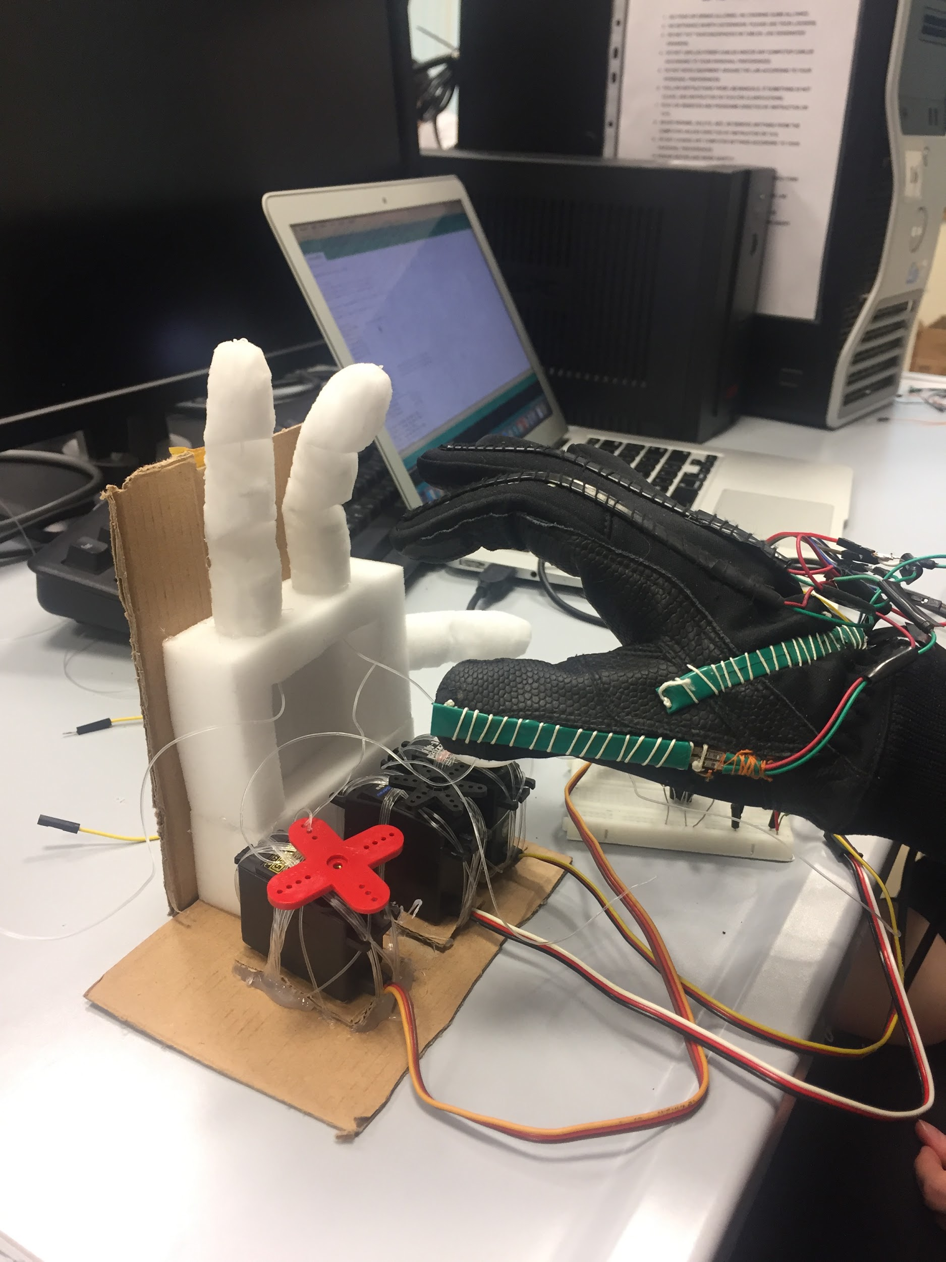

Verification
And watch our demo!
https://youtu.be/pKi1RAyJarI

Slide 13
References
Collins, Danielle. 2018. "Notch Filters And Low-Pass Filters For Servo System Resonance". Motioncontroltips.Com. https://www.motioncontroltips.com/notch-filters-low-pass-filters-reduce-resonance-servo-systems/.
"How To Control A Servo Using Pulse Width Modulation (PWM) - Smartmicrocontroller.Com". 2018. Smartmicrocontroller.Com. http://smartmicrocontroller.com/how-to-control-a-servo-using-pulse-width-modulation-pwm/.
"Galileo Experiment Guide - Learn.Sparkfun.Com". 2018. Learn.Sparkfun.Com. https://learn.sparkfun.com/tutorials/galileo-experiment-guide/sik-galileo---part-9-using-a-flex-sensor.
Zhu, Youlian, and Cheng Huang. 2012. "An Improved Median Filtering Algorithm For Image Noise Reduction". Physics Procedia 25: 609-616. doi:10.1016/j.phpro.2012.03.133.

